Slide 1

Thinking Acceleration?

Slide 2
What is Acceleration?
Acceleration is an educational intervention that moves students through an educational program at a faster than usual rate or with older than typical-aged peers.
Acceleration is one mechanism used to provide a differentiated instructional model.

Slide 3
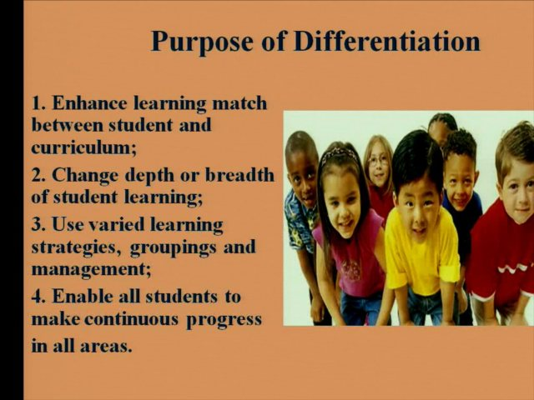

Slide 4
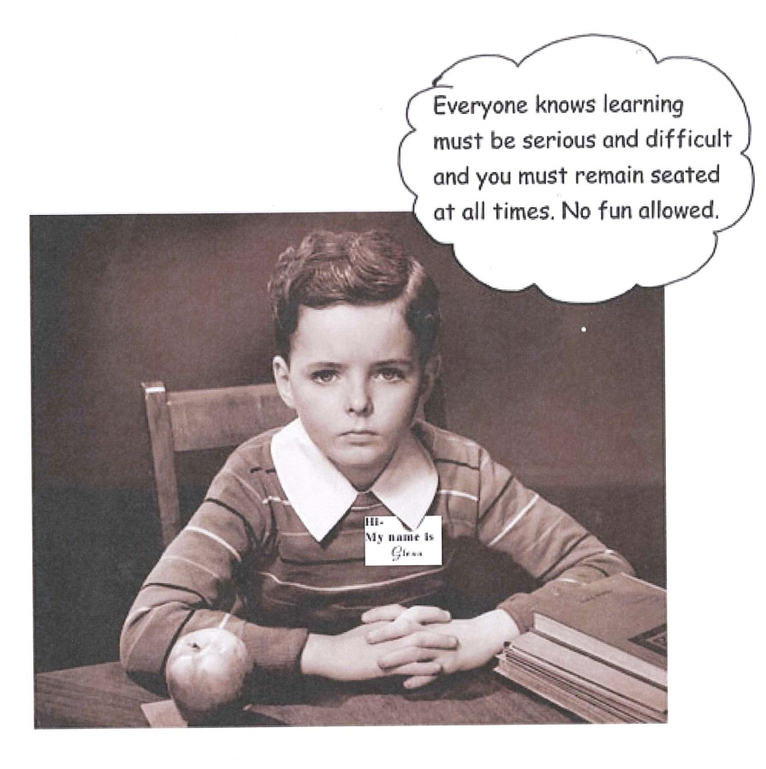

In a school where
“No Child Should be Left Bored…,” acceleration is a critical need.
$$×$$

Slide 5
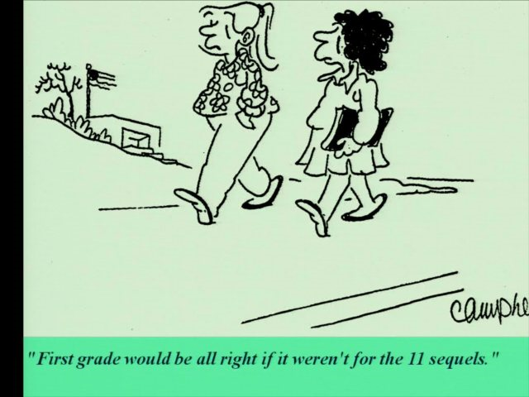

Slide 6

Acceleration is not…
Endless extra work

Slide 7
Acceleration starts with…
Determining current student knowledge

Slide 8
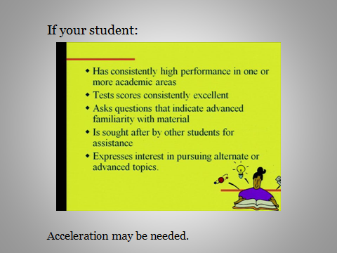

Slide 9

There are many kinds of acceleration…

Slide 10
Types of Acceleration:
Subject-matter
Combined Classes
Curriculum Compacting
Online Resource Use
Whole Grade Acceleration
Formal Whole Grade Acceleration

Slide 11
Subject Matter Acceleration
Students who are consistently ahead of the grade level standard are placed in the instructionally appropriate core class in order to meet their needs for challenge.

Slide 12
Combined Classes
Students are placed into mixed grade level classes taught at the higher grade level.

Slide 13
Curriculum Compacting
Students are pre-assessed in content area classes. If they have already mastered material, they are provided with enrichment for the curriculum area in lieu of direct instruction.

Slide 14
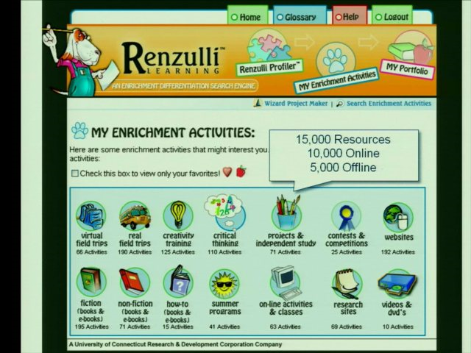

Slide 15
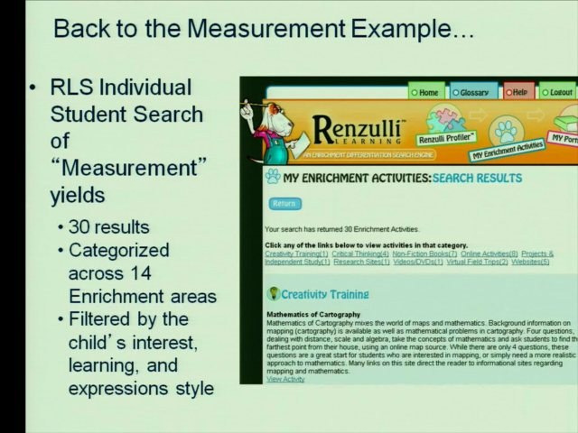

Slide 16
Online Resource Use
Students use programs like Khan Academy and Study Island to provide accelerated curriculum at the next grade level or the next content area standard.

Slide 17
Whole Grade Acceleration
Students who have shown mastery of their core content at their developmentally appropriate grade level are instructionally placed at the next grade level.

Slide 18
Formal Whole Grade Acceleration
Students who have shown mastery of their core content at their developmentally appropriate grade level are formally placed at the next grade level. This process involves use of multiple assessments, a Galileo Student Study Team meeting, parent approval, careful consideration and Principal approval.

Slide 19
Questions??

