Slide 1
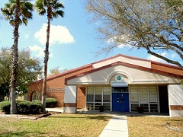
“Reach for the Stars” How YOU can help secure a Bright Future for The Galileo Dragons!!
Creative Learning … for Life
Innovation
Illumination
Inspiration
2251 Jitway Avenue, Sanford, FL 32771
321-249-9221 / tommy.miller@galileogiftedschool.org

Slide 2
Creative Learning…for Life
Innovation
Illumination
Inspiration
2251 Jitway Avenue, Sanford, FL 32771
321-249-9221 / tommy.miller@galileogiftedschool.org

Slide 3
About Your School
Founded in 2010
Principal: Michelle Nunez, M.A. Ed. Leadership
Located: Midway neighborhood, Sanford, FL
Student Population: Approximately 220
Grades: K-5 (Grade 6 in 2014-2015)
Approximate: 50/50% blend of gifted and typical learners in student population
Founded By: Dr. Michele Gill & Founding Board

Slide 4
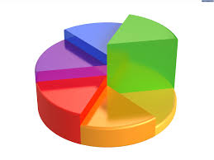
Incredible Success…and growing!
Galileo School for Gifted Learning Achievements in 2013
Galileo is an "A" rated school.
In FCAT Reading: Galileo Students scored the highest in 3rd, 4th, and 5th grade out of all SCPS Schools.
In FCAT Math: Galileo Students scored the highest out of all SCPS in 4th and 5th grade math!!!
In FCAT Science, 5th graders are in the top 1% in Florida.
Galileo's Odyssey of the Mind Team qualified for and participated in the World Championship at Michigan State University.
ALL students consistently achieving above average.

Slide 5
Incredible Success…and growing!
Galileo School for Gifted Learning Achievements in 2013
Galileo is an "A" rated school.
In FCAT Reading: Galileo Students scored the highest in 3rd, 4th, and 5th grade out of all SCPS Schools.
In FCAT Math: Galileo Students scored the highest out of all SCPS in 4th and 5th grade math!!!
In FCAT Science, 5th graders are in the top 1% in Florida.
Galileo's Odyssey of the Mind Team qualified for and participated in the World Championship at Michigan State University.
ALL students consistently achieving above average.
AND…

Slide 6
GALILEO 2013
Congratulations
Dragons!!

Slide 7
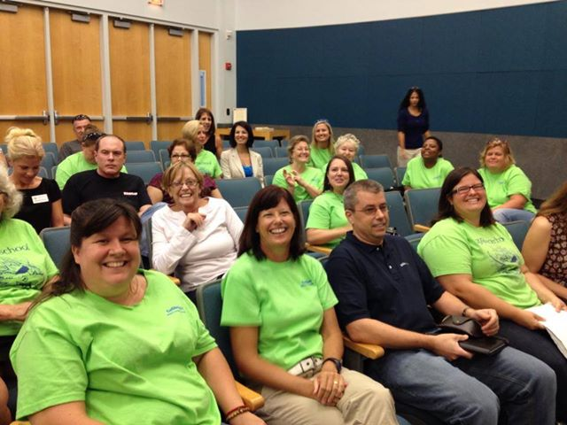
Middle School Expansion
In October 2013, the SCPS Board approved an expansion of Galileo School for 6-8 grades.
One 6th grade class planned for 2014-15; one 7th grade in 2015-16; and, one 8th grade in 2016-2017

Slide 8
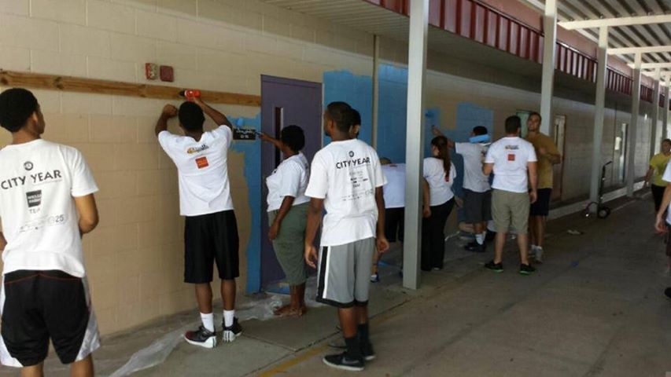
Infinity…and Beyond
Next Generation School Building
District Lease to expire for existing facility in 2016
Independently managed school building would ensure long-term sustainability of school
New or pre-existing building could be optimized for the gifted learning environment

Slide 9
Technology Enhancements
Individual iPAD per student
Additional IT Capabilities:
STEM Lab
Foreign Language Lab
Testing Lab

Slide 10
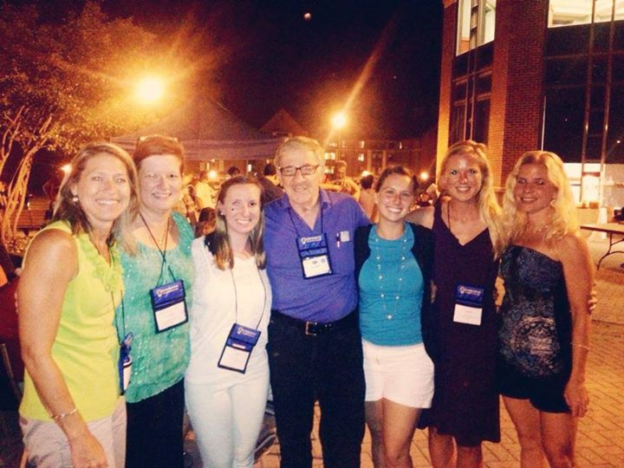
Gifted Teacher Training
Staff & Faculty training in gifted learning has made a significant impact on the classroom instruction at Galileo School. The most comprehensive update training available each year is held for 5 days during the summer break at the Confratute Symposium, hosted by the University of Connecticut. The cost is approximately $2,000 per attendee. This is a total investment of almost $30,000 for Galileo per annum.

Slide 11
How it Happens
3 Tier Approach
Friends & Family
Local Business
Corporations & Foundations

Slide 12
Friends & Family
Dragon Club Donors
Parents
Grandparents, Godparents & Friends
The Folks You Know that We Don’t (BTW, We could use help from any celebrities that you may know…those folks are great for fund raising)

Slide 13
It Takes a Village…with $$$
Local Business Community
Bronze: ($50-$499) e.g. Mel’s Diner, Sparks
Silver: ($500-$999) e.g. Gators Dockside
Gold: ($1,000-$2,499) e.g. Lowe’s, Ruth’s Chris
Platinum: ($2,500-$5,000) e.g. EA Sports, Siemens

Slide 14
It Takes a Village…with $$$
Local Business Community
Bronze: ($50-$499) e.g. Mel’s Diner, Sparks
Silver: ($500-$999) e.g. Gators Dockside
Gold: ($1,000-$2,499) e.g. Lowe’s, Ruth’s Chris
Platinum: ($2,500-$5,000) e.g. EA Sports, Siemens

Slide 15
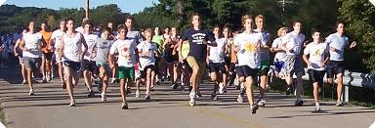
Corporations & Foundations
Corporate Sponsors
($5K - $$$ No limit ☺) e.g. Morgan & Morgan, Gates Foundation, Darden Foods

Slide 16
What can You Do for Your Child?
Commit Financial Resources to your School
Enlist the Support of your Contacts
Invest Time and Energy for us to Win
Be a Positive Advocate for Galileo
Tell us what You can do to Help
Be a part of us Reaching the Stars!!

Slide 17
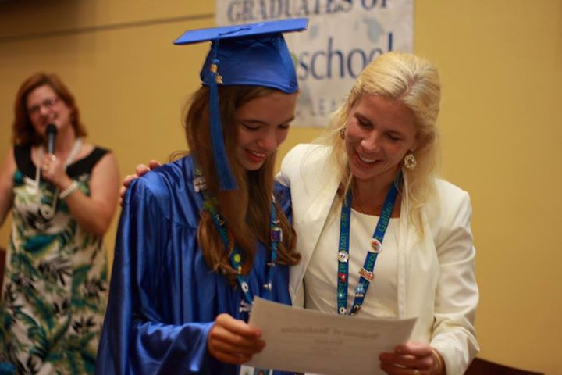
Doesn’t Your Child Deserve the Best? Make it Happen. Right Here. Right Now.

Slide 18
Thank You For The Future! Contact us: 321-249-9221 tommy.miller@galileogiftedschool.org
Creative Learning … for Life
Innovation
Illumination
Inspiration

